Slide 1
TextArea Demo
I modified the following example to support DAPP development

Slide 2
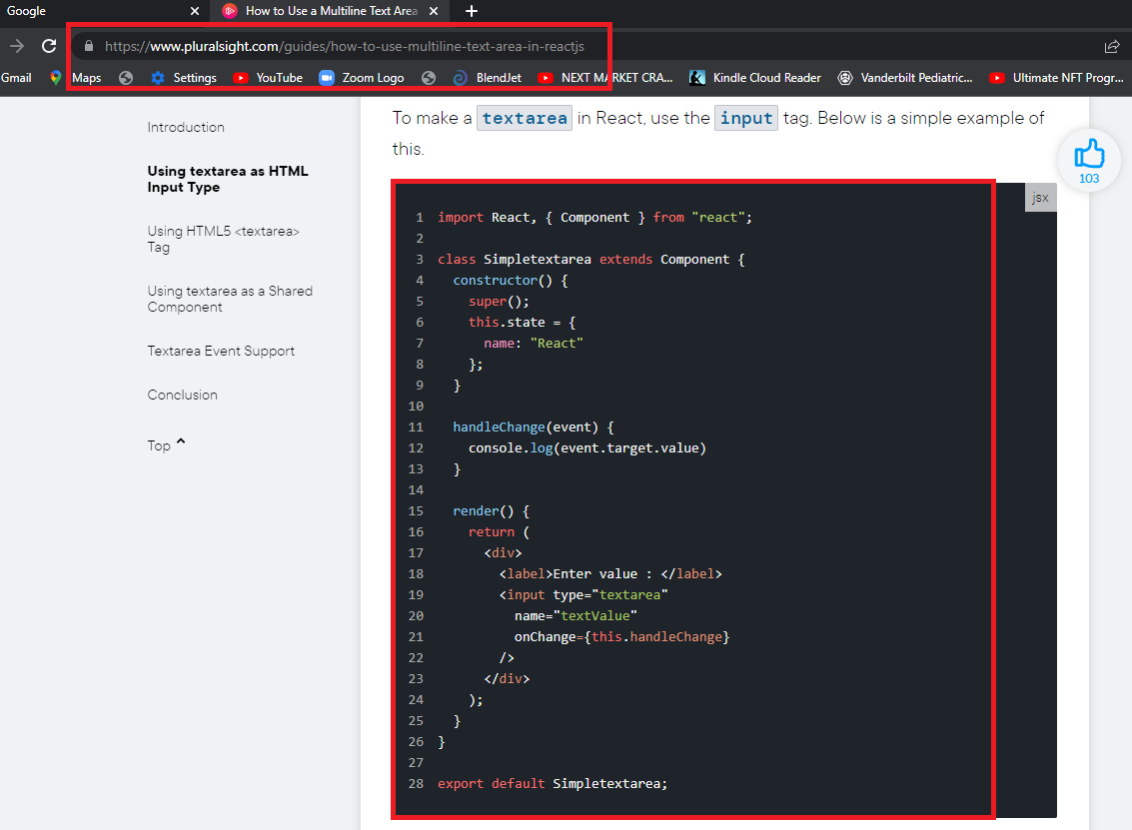

Slide 3
